Slide 1

IPS ACADEMY Rau AB Road [Indore]
Presentation On Project “Online Learning”
Designed by-
Anuja Rane
Zeeshan Ansari
Snehal Khaire

Slide 2
Introduction –Hello Everyone We hope you all are doing great and having healthy life. Here we the students of SOC department IPS ACADEMY have prepared a website, the name of our website is “Smart Learning” in this website we have created a platform for the users who are willing to learn different computer languages.
This website contains courses namely
Web technology
C language
C++ language
Php
Python
Java

Slide 3
SPECIFICATION
Front end- HTML , CSS
Back end –Mysql

Slide 4
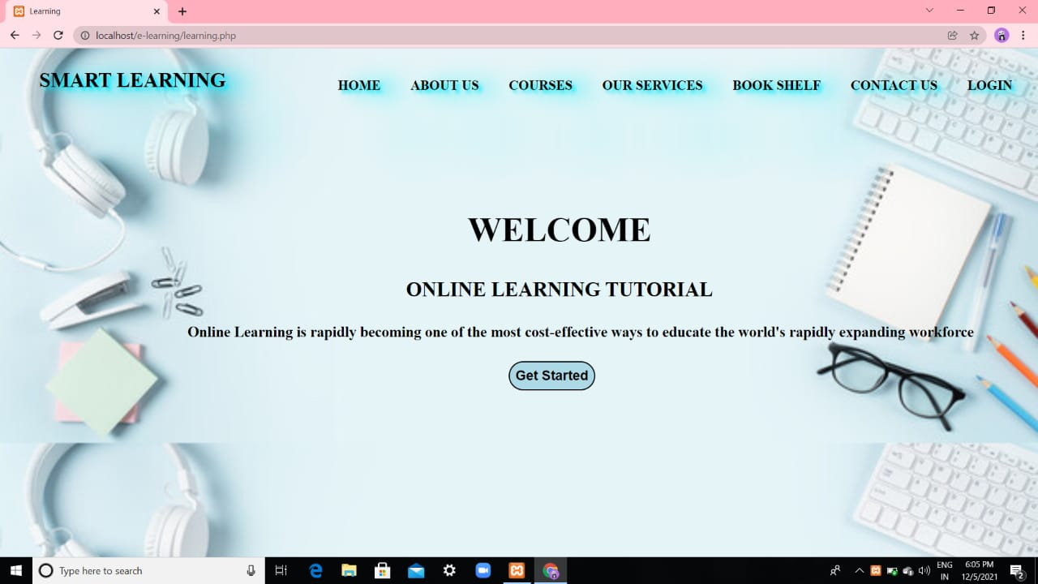
Main Page This is the main page of our website which will appear for the first when the user visit to our site.

Slide 5
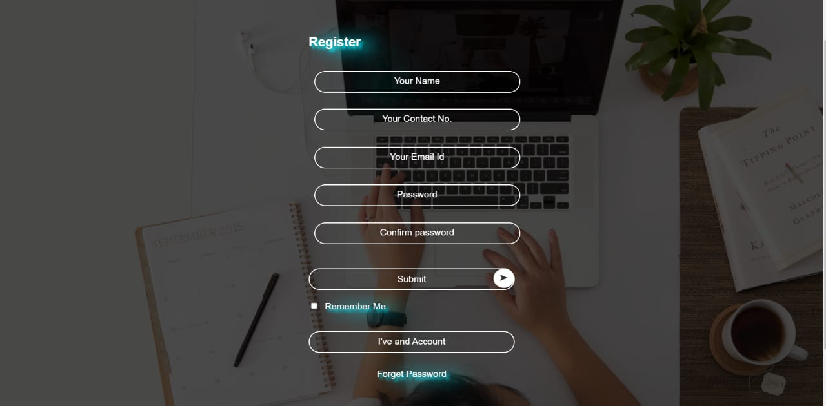
Registration Page- This is the registration page for the new comers.

Slide 6
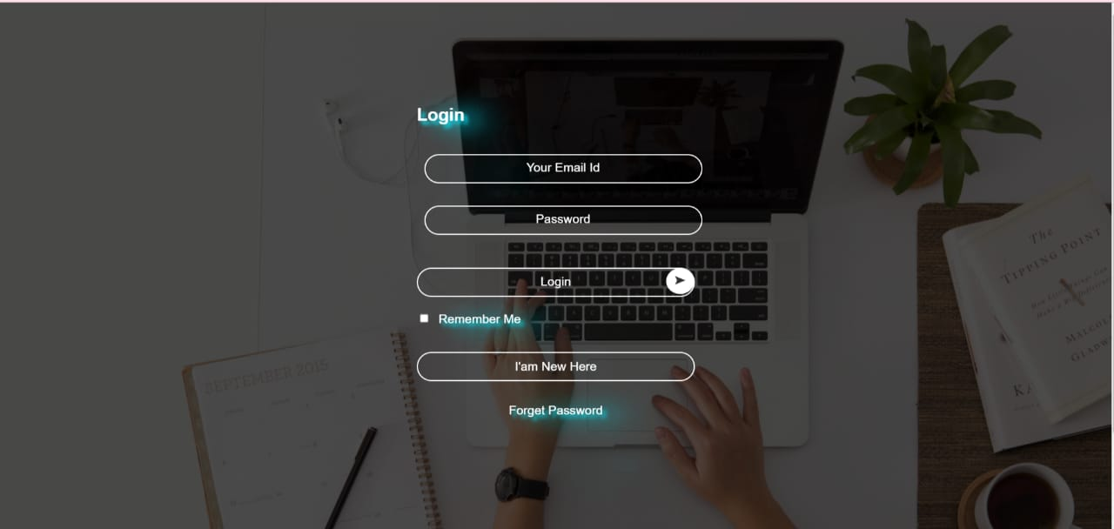
Login Page- This page is for the existing user, who will continue there learning through login.

Slide 7
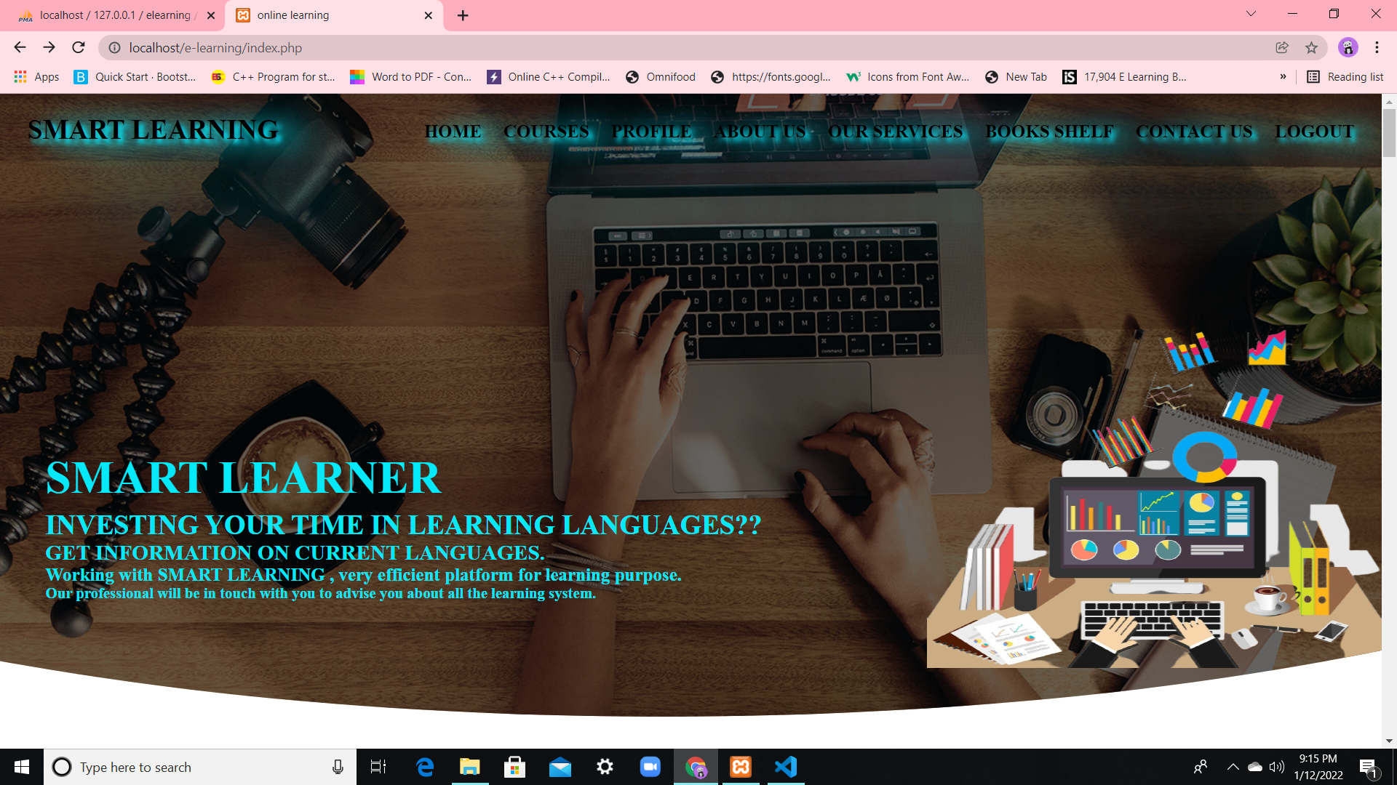
Home Page-This page is the page which will appear after login or registration process.

Slide 8

About Us- This page gives a basic description about the content of our website what the website is about how it works and so on.

Slide 9

Our Courses-This page contains the name of the courses provided by us.

Slide 10
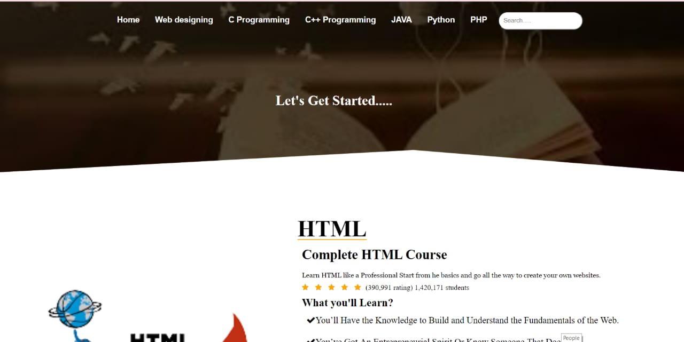
Inside the Courses Section-This is the inside view of one of the courses the name of this particular course is HTML.

Slide 11
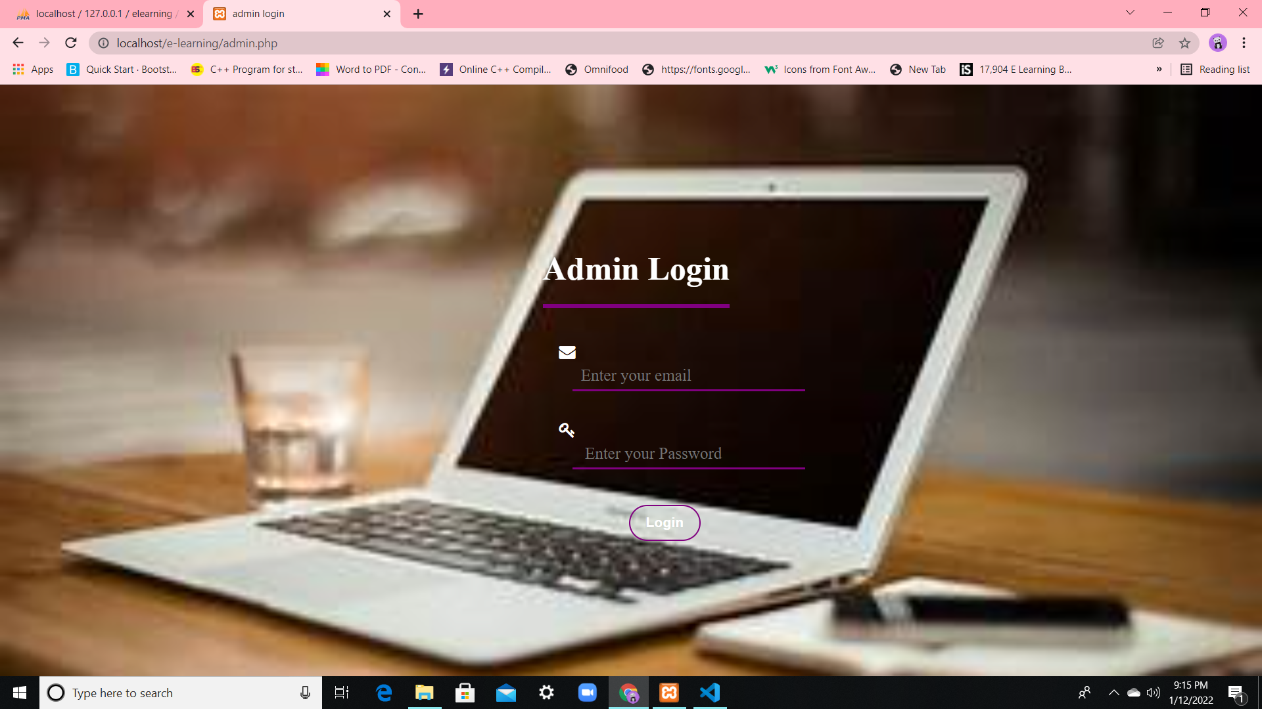
Admin Login- This page is for the admin to login in so that they can make the desired changes in the website like adding or removing any course and so on.

Slide 12
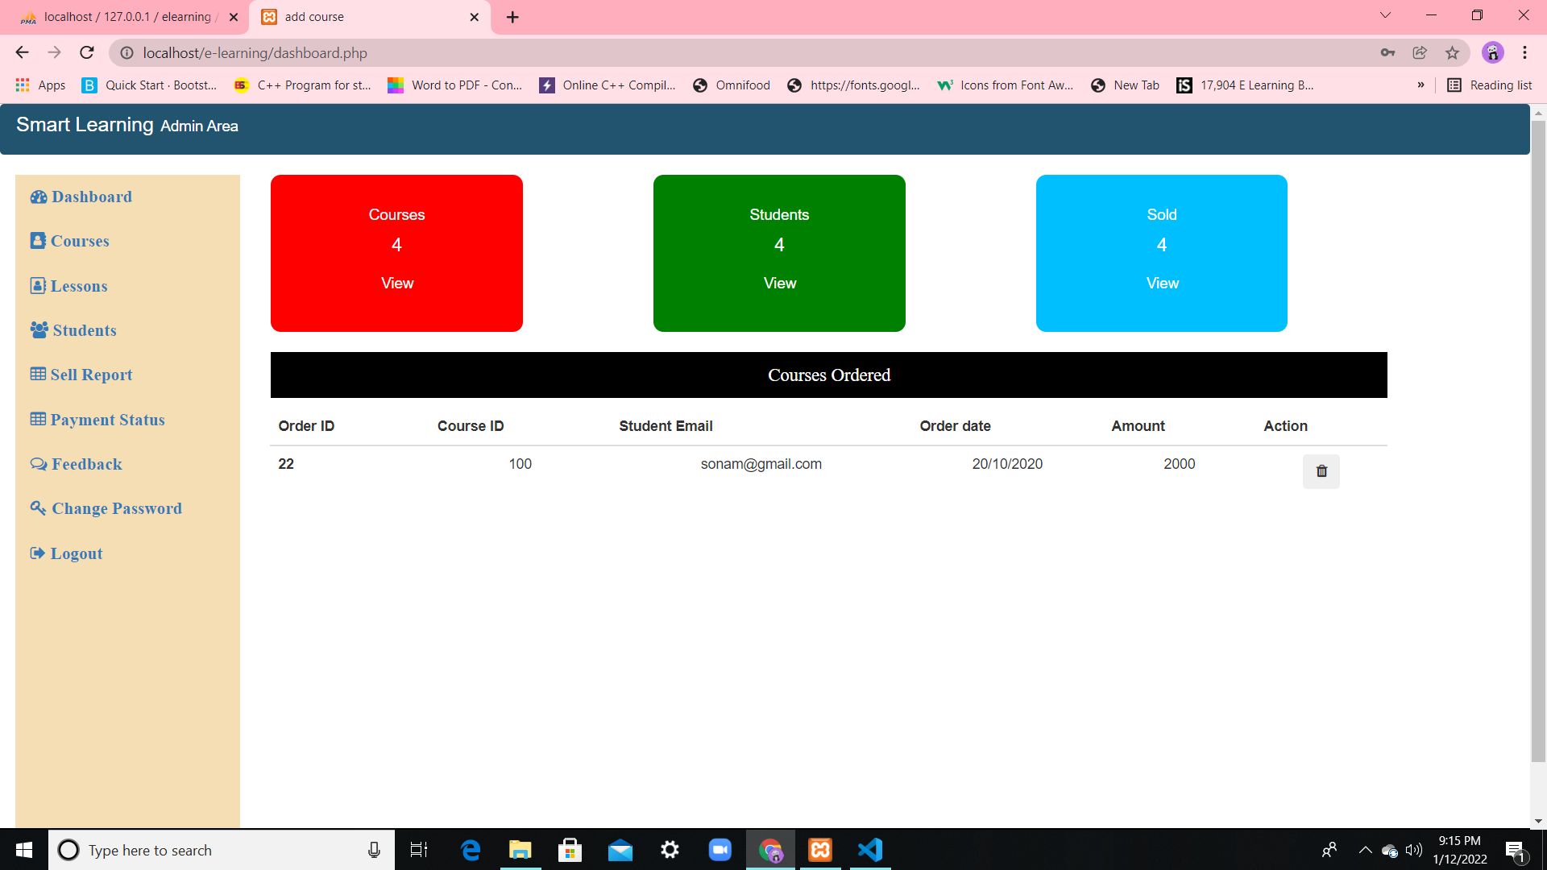
Admin Page-This is the admin page from where admin can perform the desired task.

Slide 13
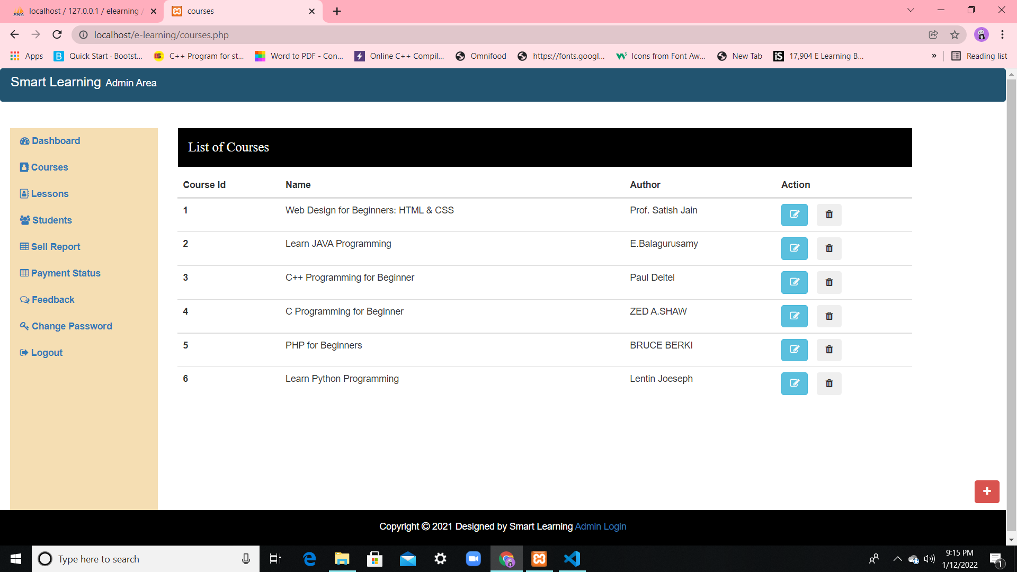
Courses-This is the section of courses where list of courses is provided.

Slide 14
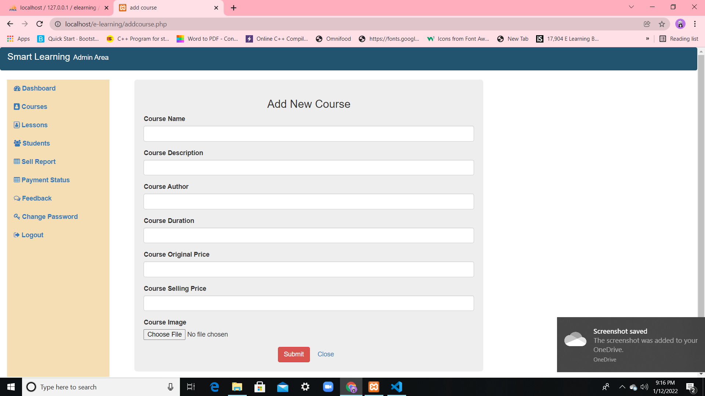
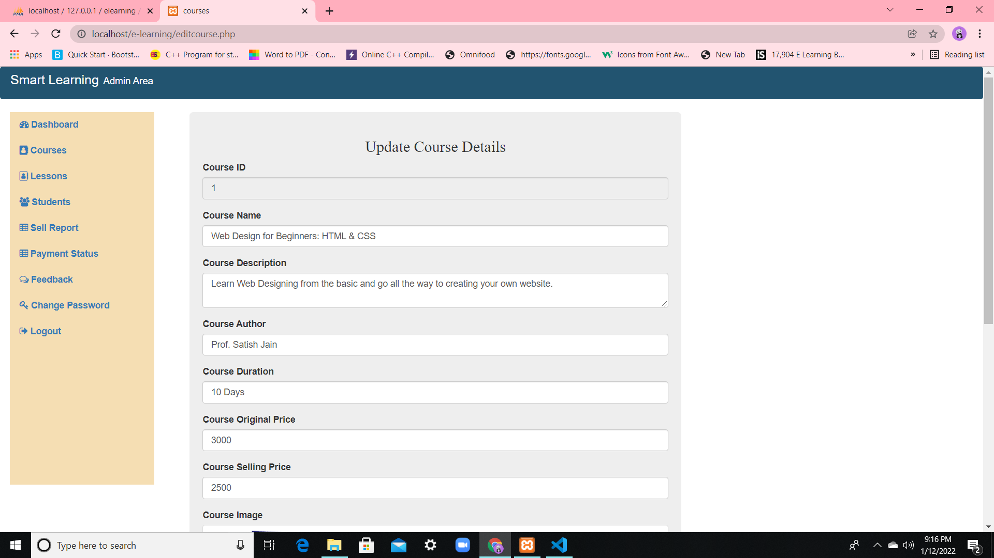
Features of Admin Panel
Page for the admin to add new course.
Update course detail

Slide 15
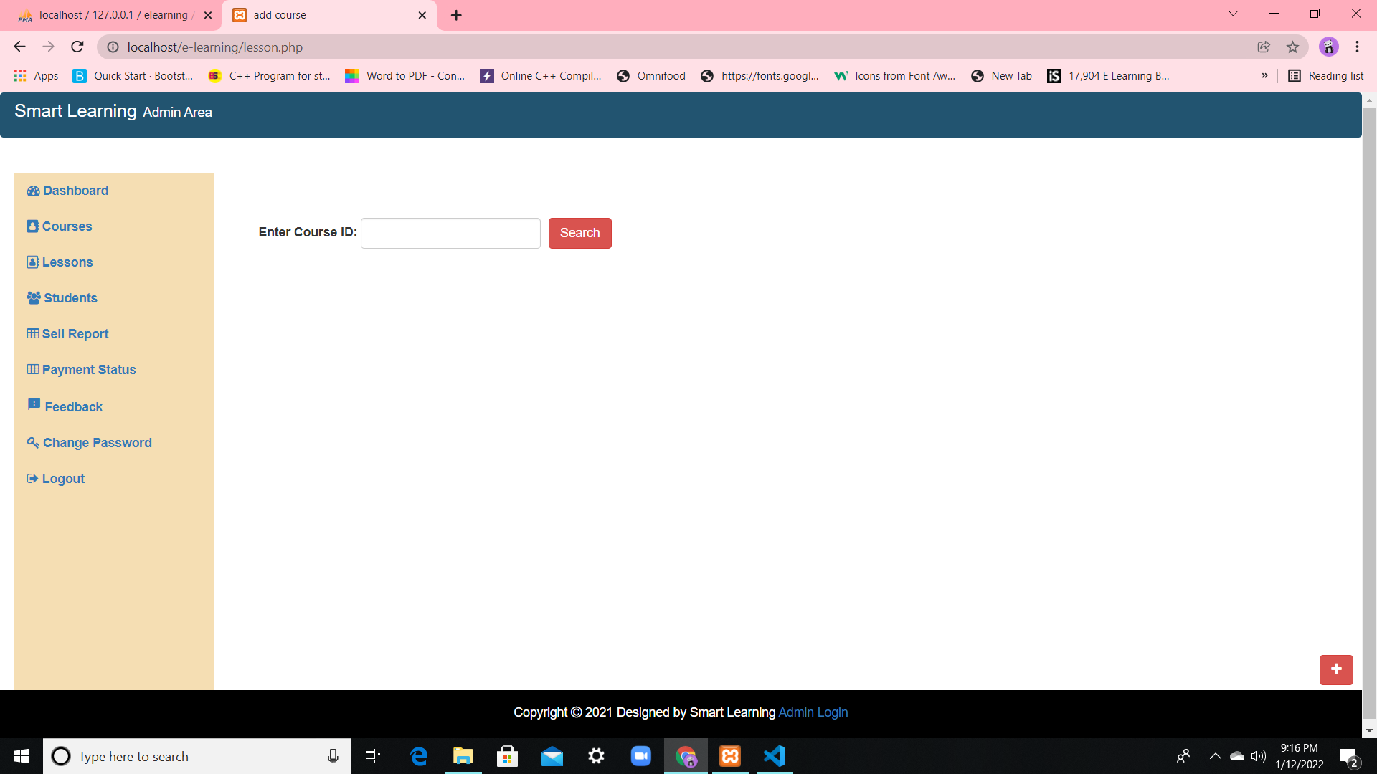
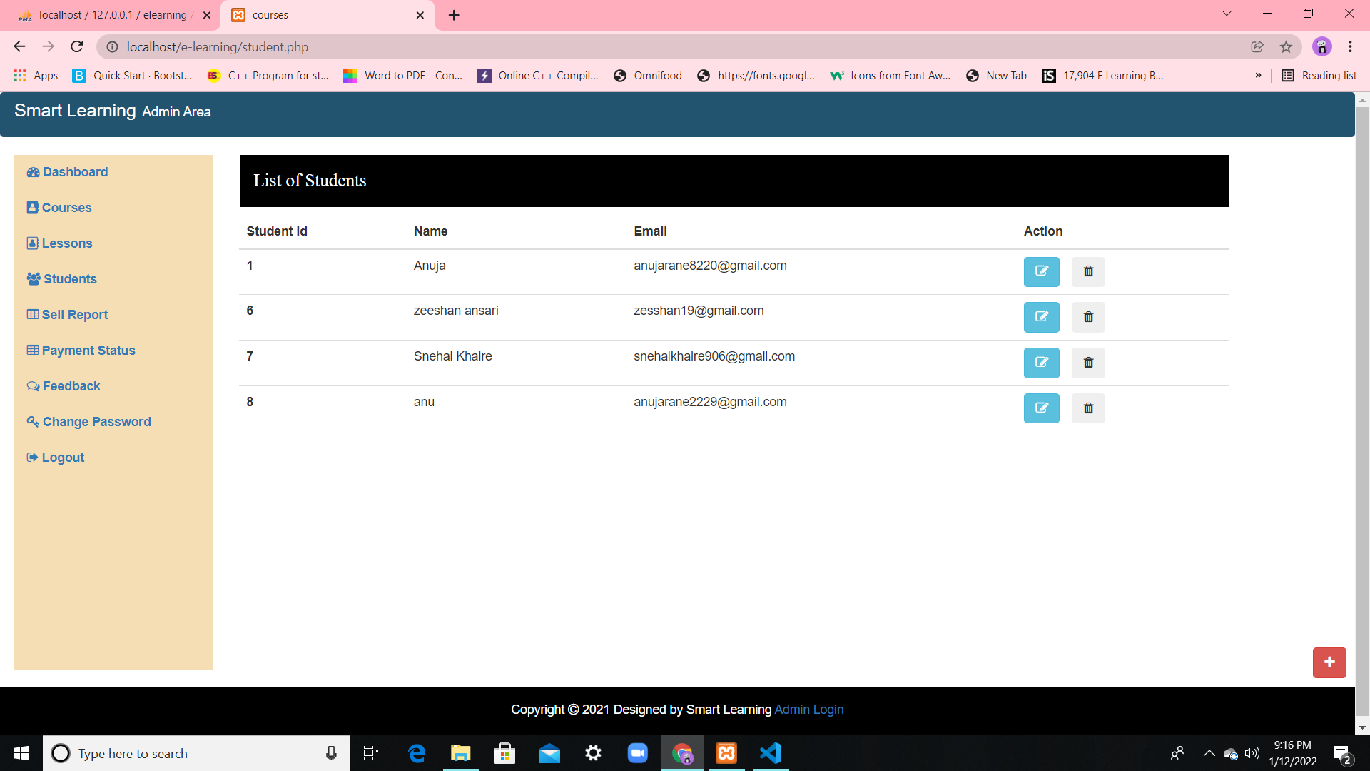
Features Of Admin Panel
Enter Course Id
List of students

Slide 16
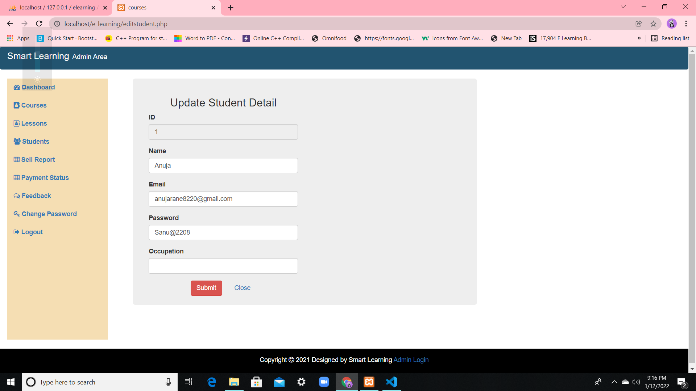
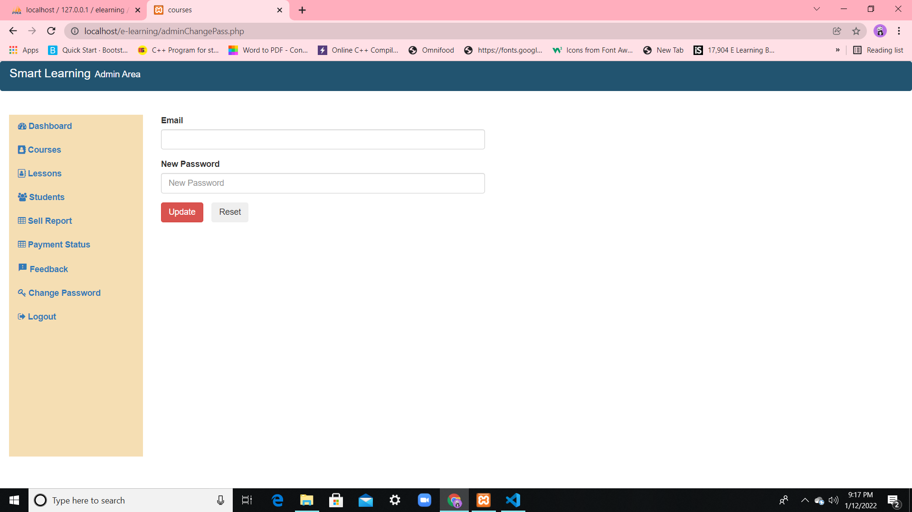
Features Of Admin Panel
Update Student Details
Email and password update

Slide 17
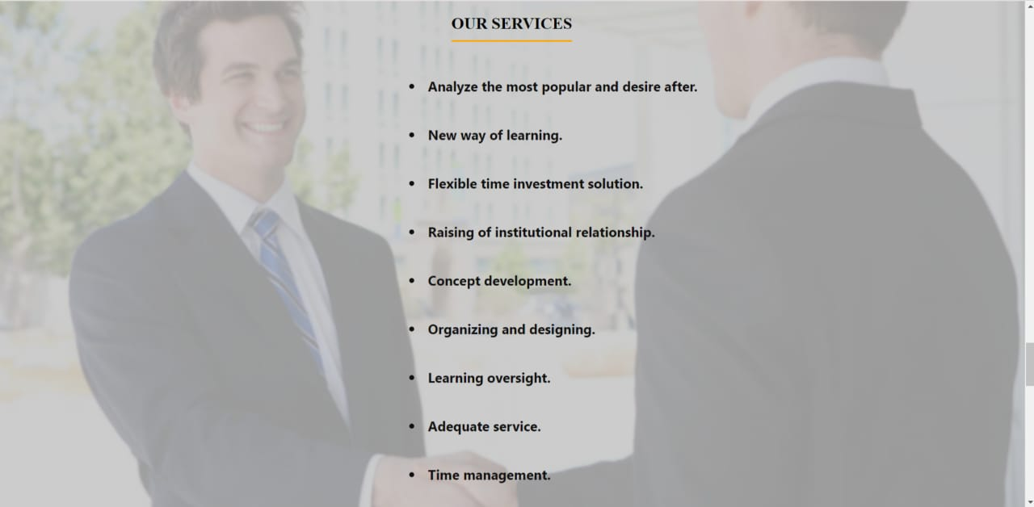
Our Services- This page is to gives a small description for the services provided by us to the user.

Slide 18
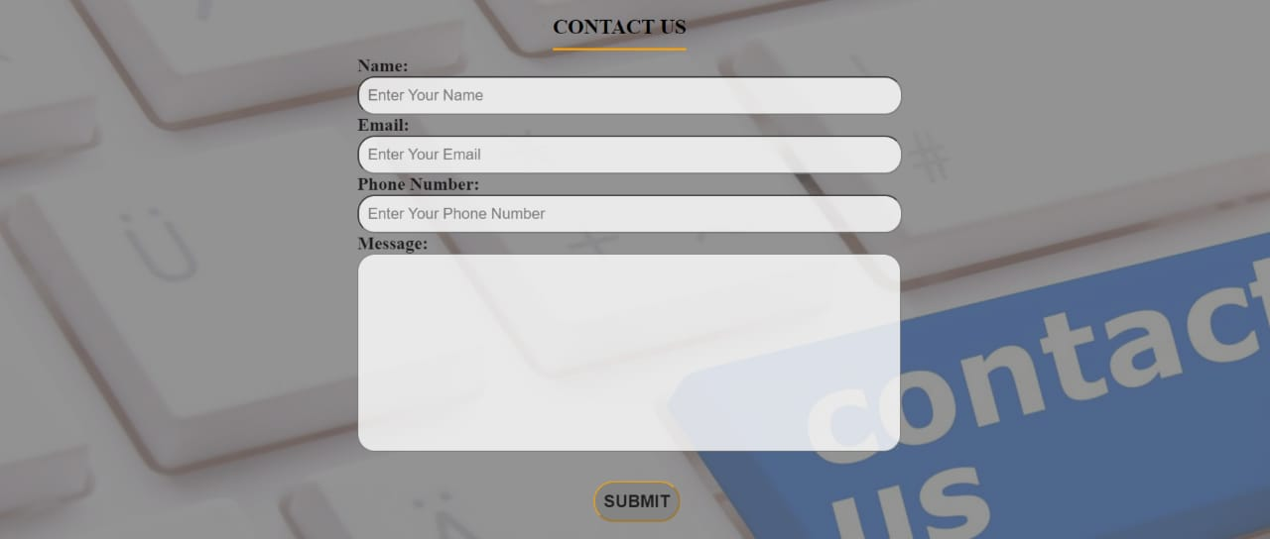
Contact Us-This is the contact us page which will redirect the users message to us.

Slide 19
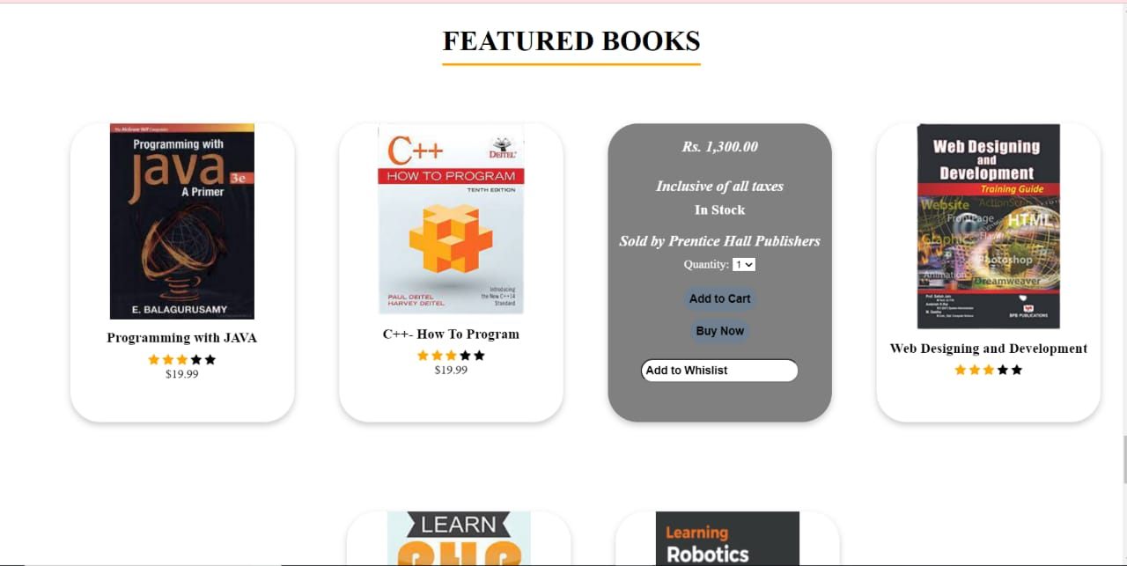
Featured Books- This is the page which contains some course books, so if any of the user wants to use them they can refer it.

Slide 20
THANK YOU

